Slide 1

Machine Learning Exam
By Hoyt Smith

Slide 2
The Assignment
Machine Learning:
  Train a model to classify different breast cancer types
  Explain the model and its reliability
Deep learning & SHAP
  Train a Neural Network to classify articles of clothing from images
  Use SHAP to explain and visualize how it works

Slide 3
Machine Learning: The Dataset
The dataset contains 157 samples (rather low)
The dataset has 59 features (and a class feature)
3 different classifications (b'HER2+', b'HR+', b'TN')
Only 2 missing pieces of data (substituted using mean values)

Slide 4
Machine Learning: The Model
I used an SVM with linear kernel
Using grid search I found the best parameters to be:
  C: 0.175
  Gamma: 0.0001

Slide 5
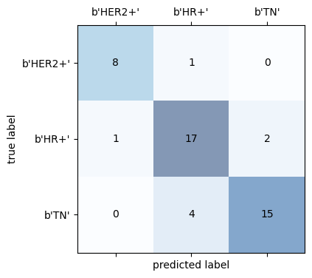
Machine Learning: Evaluating the Model
Accuracy of the model:
Train data: 0.93
Test data: 0.83
In the confusion matrix on the right, we can see how reliably the model accurately predicts the different types of breast cancer.

Slide 6
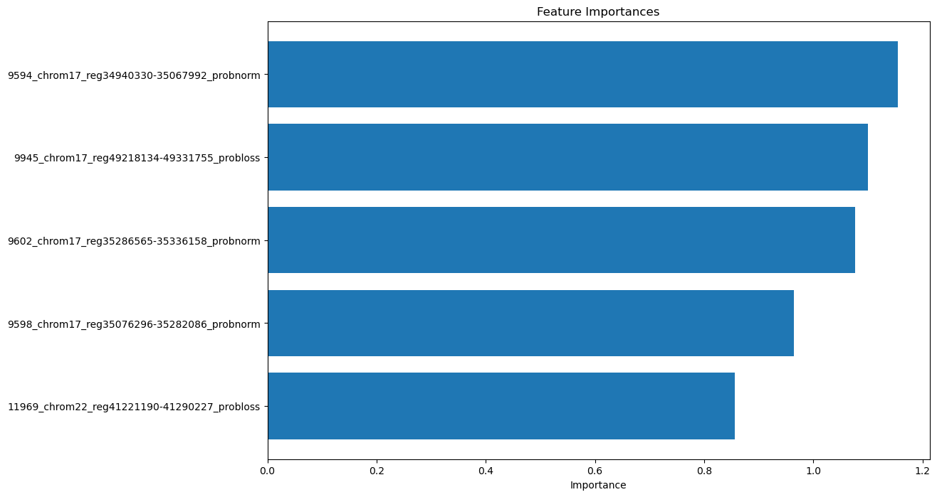
Machine Learning: Most Important Features

Slide 7
Machine Learning: Conclusion
The model can reliably differentiate breast cancer types, HOWEVER:
  The low amount of samples gives us a low confidence that this model could work at a larger scale
  The dataset only contains data from patients already diagnosed with breast cancer, meaning that it cannot be used to diagnose the undiagnosed.
For a better model, we would like:
  More samples, and;
  Samples from people WITHOUT breast cancer.

Slide 8
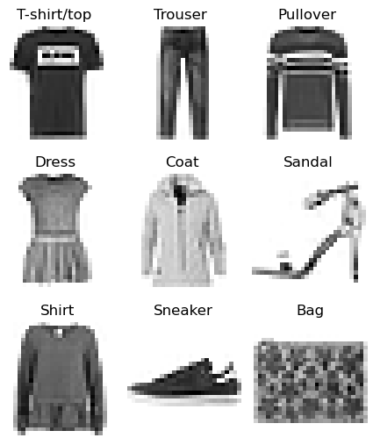
Deep Learning: The Dataset
Tens of thousands of samples
Each sample is an image of 28x28
No color; each pixel is just 1 feature
10 different classifications

Slide 9
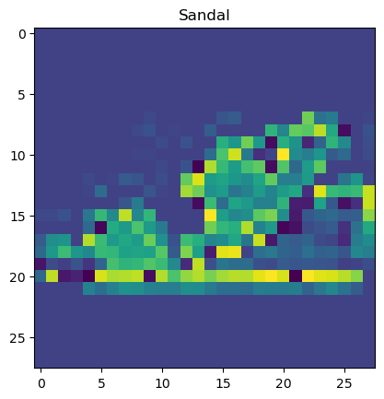
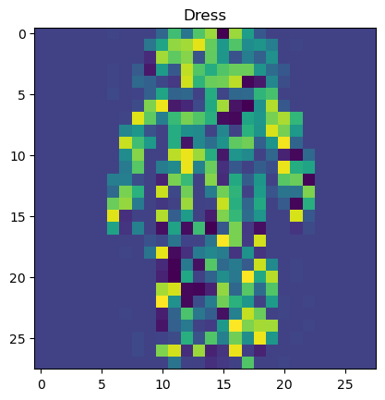
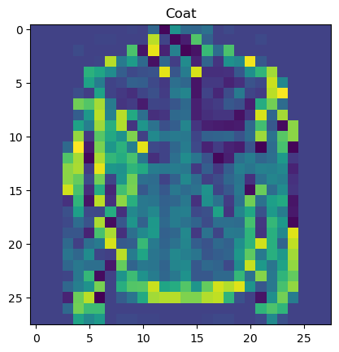
Deep Learning: Data Preprocessing
We normalize the data to speed up the training process
The images look strange to us, but aren't a problem for the NN

Slide 10
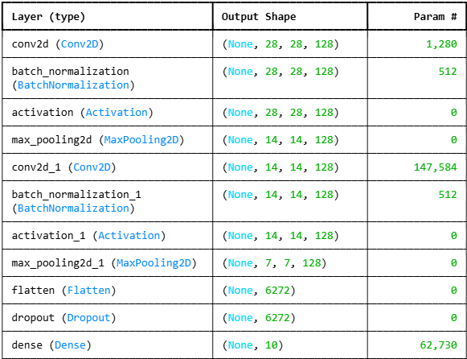
Deep Learning: Training the model
Not too many layers were needed
MaxPooling is used to make the training more efficient and not miss the most important features
Dropout is used to prevent overfitting and improve generalization of the NN

Slide 11
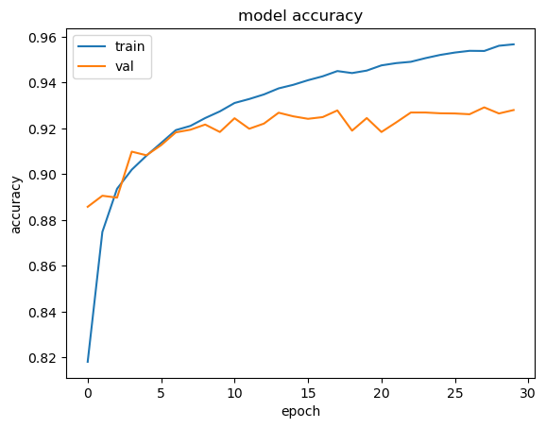
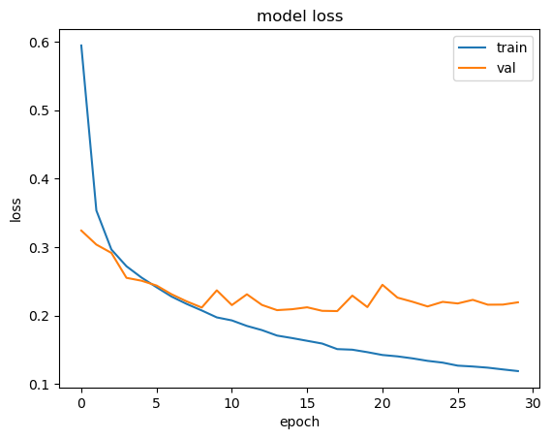
Deep learning: Evaluating the model
Accuracy:
  Train: 0.96
  Validation: 0.93
  Test: 0.92
Loss:
  Train: 0.12
  Validation: 0.22
  Test: 0.24

Slide 12
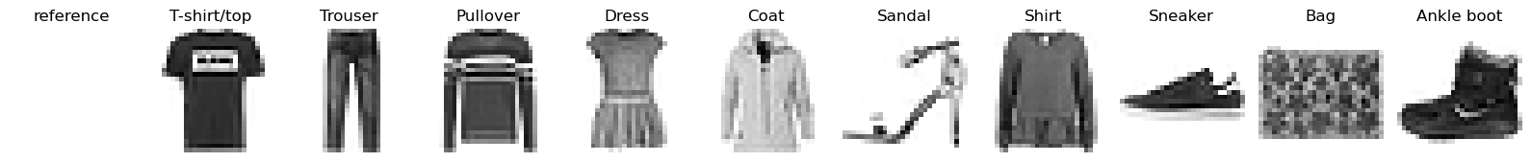
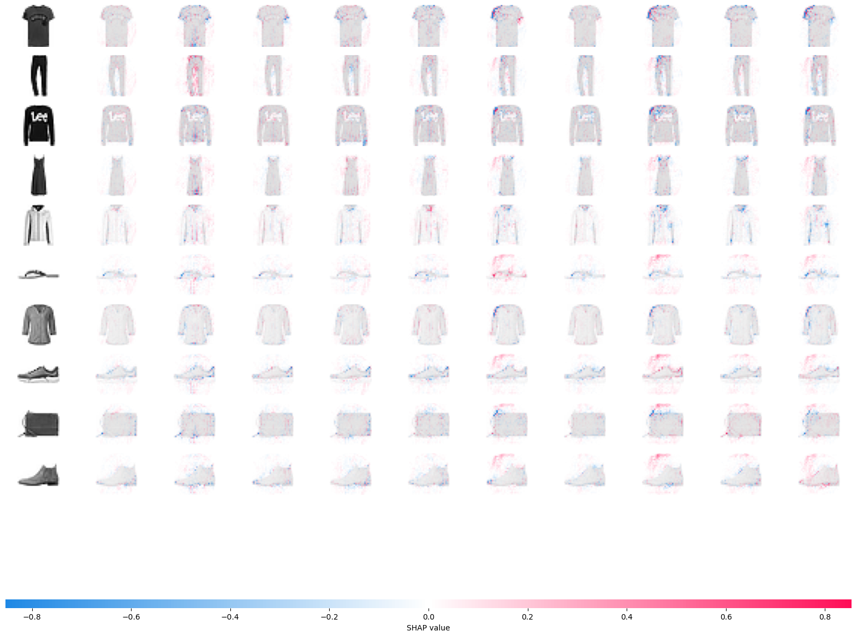
Deep Learning: Using SHAP (1)
Using SHAPley values, we can determine the pixels that are more or less important in classifying the images
In the image matrix on the right, red pixels mean that those pixels from the image of that row are more likely to classify the image with the class of that column.
Blue indicates the opposite.
Let us take a closer look...

Slide 13
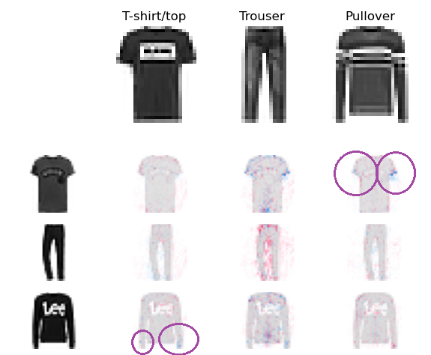
Deep Learning: Using SHAP (2)
When taking a closer look, we can see clearly that the model differentiates between t-shirts and pullovers by the length of the sleeves.

Slide 14
THANK YOU FOR YOUR ATTENTION!

